Slide 1

Let Your Cores Run Wild!
Coordination-free
Parallel Machine Learning
Dimitris Papailiopoulos
BVLC Fall 2015 Retreat

Slide 2
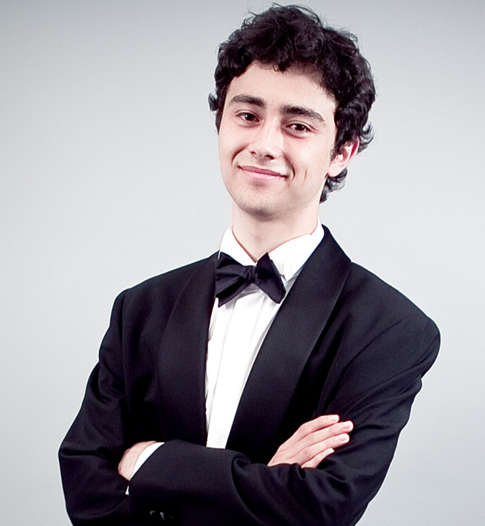





Joint Work With
Horia
Mania
Xinghao Pan
Samet
Oymak
Ben
Recht
Kannan
Ramchandran
Michael I.
Jordan

Slide 3
What is this talk about?
The Abundance of Stochastic Gradient in Large-scale ML
Parallel and Asynchronous Machine Learning Algorithms
Theoretical and Practical Challenges
A framework for Asynchronous Stochastic Optimization
An asynchronous framework to Parallelize sparse algorit
A novel Parallel Framework for General Sparse Algorithms
Noisy viewpoint:
Asyncronous( Algorithm( DATA ) ) Algorithm( DATA + Noise )

Slide 4


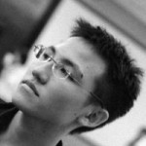


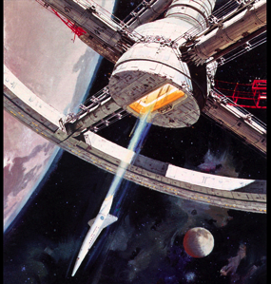




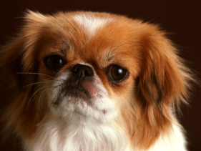

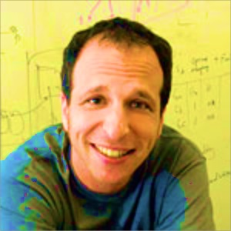





Product Recommendation
Classification
All Solved by an
Über-algorithm
Topic Modeling
DeepNets
Why is it raining??
PCA
I love the rain <3
<3 this game #Go Warriors
Graph Clustering
The Warriors Rock!
Feel the Bern!

Slide 5
Stochastic Gradient
Comes with Different Names and in different flavors
ML / opt / statistics
Perceptron
Incremental Gradient
Back Propagation (NNs)
Oja’s iteration (PCA)
…
Has been around since forever
For a reason
Goal:
Find the best model that minimizes the loss for each data point.
- Idea:
What if we do that greedily over every data point?
loss for data point i
Stochastic Gradient Method:
A Meta-algorithm

Slide 6
Stochastic Gradient: the Über-algorithm
Data points
Model
1
Sample
2
2
3
4
Step1: Pick random data point

Slide 7
Stochastic Gradient: the Über-algorithm
Data points
Model
1
Read
2
3
4
Step 2:
Read Variables

Slide 8
Stochastic Gradient: the Über-algorithm
Data points
Model
1
Compute grad. of local loss
2
3
4
Step3:
Compute local function

Slide 9
Stochastic Gradient: the Über-algorithm
Goal: Parallelize this
Data points
Model
1
Update Model
2
3
4
Step4:
Update Model

Slide 10
Is Stochastic Gradient
“Embarrassingly Parallel”?

Slide 11
Challenges in Parallel Stochastic Gradient
Data points
variables
Say, I run parallel Updates.
If there is no conflict… I’m good.

Slide 12
Challenges in Parallel Stochastic Gradient
Data points
variables
Say, I run parallel SG.
Issues: What happens if there is conflict… ??
Approach 1: Coordinate? Approach 2: Don’t Care ?

Slide 13
Prior (2011) Work
Mostly based on the “Coordinate” Approach
Long line of theoretical work since the 60s [Chazan, Miranker, 1969]
Foundational work on Asynchronous Optimization Master/Worker model [Tsitsiklis, Bertsekas, 1986, 1989]
Recent hardware/software advances renewed the interest Round-robin approach [Zinkevich, Langford, Smola, 2009] Average Runs [Zinkevich et al., 2009] Average Gradients [Duchi et al, Xiao et al. 2010]
Major Issue:
Lots of Synchronization and Communication!

Slide 14

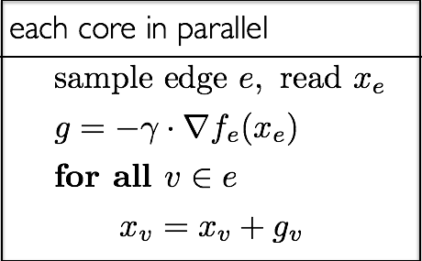
HOGWILD! 2011
Run SGD in parallel without Synchronization
SVM RCV1 (10 cores)
Impact: Google’s Downpoor SGD, Microsoft Project Adam, …, use HW!
Renewed research interest on Async. Lock-free Optimization
Issues:
1. updates can be very old (stale reads of the model)
2. results can be overwritten by other cores/worker threads

Slide 15
How to Analyze?
General Analysis Framework For Asynchronous and Lock-free Algorithms?
- [Niu, Recht, Re, and Wright, 2011] give the first
convergence analysis of Hogwild! Issues:
- (over) simplified read/write model. [consistent reads, single coordinate updates, etc]
- lengthy and tedious derivations
Several Async+lock-free algorithms follow
using similar assumptions, and/or analysis:
- [Duchi et al, 2011], [Liu et al, 2014, 2015], [Avron et al. 2014], [De Sa et al, 2015], [Lian et al., 2015], [Peng et al., 2015]

Slide 16
A ``Noisy” Iterates View of Asynchronous Algorithms
Main Idea
Perturbed Iterate Analysis for Asynchronous Stochastic Optimization
[Mania, Pan, Papailiopoulos, Recht, Ramchandran, Jordan, 2015]

Slide 17
Understanding Asynchrony
timeline
Core 1
Sample 1
Core 2
Sample 2
Core 3
Sample 3

Slide 18
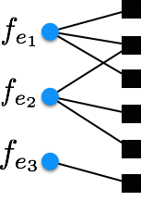
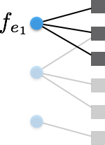
Understanding Asynchrony
timeline
Core 1
Sample 1
Core 2
Sample 2
Core 3
Sample 3
“Serialized” Processing Timeline

Slide 19
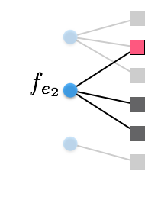
Understanding Asynchrony
timeline
Core 1
Sample 1
Core 2
Sample 2
Core 3
Sample 3
“Serialized” Processing Timeline

Slide 20
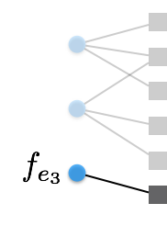
Understanding Asynchrony
timeline
Core 1
Sample 1
Core 2
Sample 2
Core 3
Sample 3
“Serialized” Processing Timeline
Q: What causes asynchrony “noise”? A: “noisy reads” of the coordinates in the overlap

Slide 21
Asynchrony Noise
Asynchrony causes an “error” iff sampled data points are in conflict
As long as no more than n/av.deg. Functions are not processed concurrently, there should be bounded conflicts
Pr( two samples conflict ) = av. conflict degree / #functions
Thm. (informal) : if you use less than O(n/av.deg) cores,
HW! gets a provable linear speedup
Lemma:
“if E{#conflicts per sample} = O(1), then asynchrony does not affect the convergence rates”

Slide 22
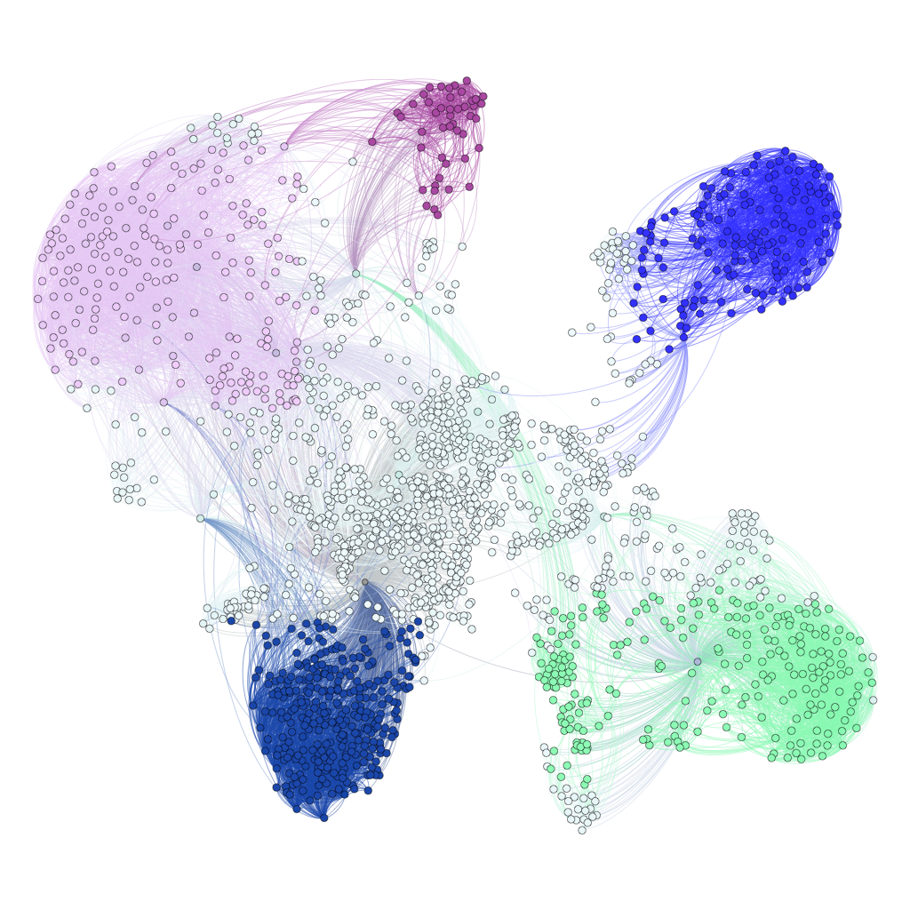
Perturbed Iterates is General
It turns out that several asynchronous algorithms can analyzed by
Asynchronous Coordinate Descent
Asynchronous Sparse SVRG
- Same “noisy” viewpoint used for a parallel graph clustering algorithm [Pan, Papailiopoulos, Recht, Ramchandran, Jordan, NIPS2015]
Asyncronous( Algorithm( DATA ) ) Algorithm( DATA + Noise )

Slide 23
Async. is great in Practice
Example: Combinatorial Graph Clustering
Clustering Billion-Edge Graphs in <10 sec.
12-15x Speedup on 32 threads

Slide 24
Future Directions
- The framework in it’s current form implies that:
Fine for sparse SVM, text data, graph/vision cuts, or for high Dropout…
But some problems are not sparse or convex (like training general NNs)
Open Problems:
Do Asynchronous SG algorithms Converge for Dense Problems?
- Holy grail: Can we show convergence of SGD on nonconvex NN problems?
- Does Async. Noise help escape local minima?
Sparsity + convexity => linear speedups
In practice, what matters is that sampled data points
are somewhat uncorrelated
(think of cat-cat vs cat-dog samples)

Slide 25
What if we just care about speedups?
Say that I “believe” that algorithm A is good for problem P.
Can we claim provable speedups, without much knowledge of A?
Can we say something useful by just looking at the “access patterns” of an algorithm induced by the problem P?

Slide 26
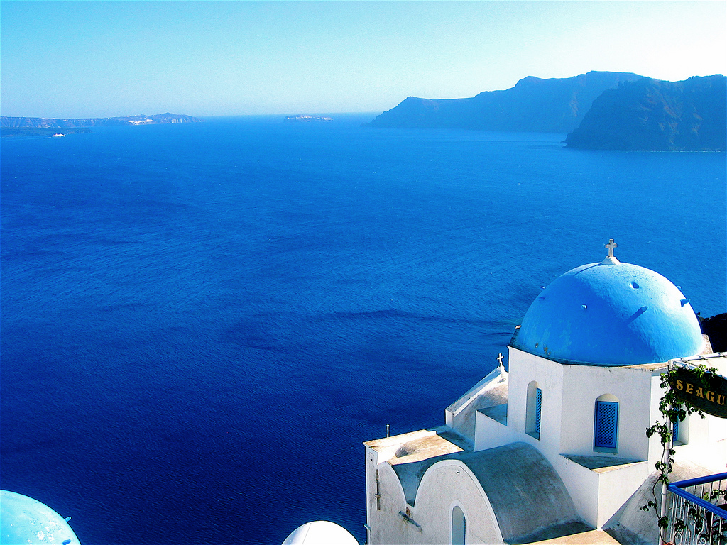
is a framework for Parallelelizing ML algorithms
- Lock-free
- Asynchronous
- No memory contention
- Serializable
- One analysis fits all
- Access Locality (NUMA aware impl.)
Like HOGWILD!
Unlike
HOGWILD!

Slide 27
Sample Data Points (carefully)
Compute Conflict Groups
Process Conflict Groups in Parallel

Slide 28
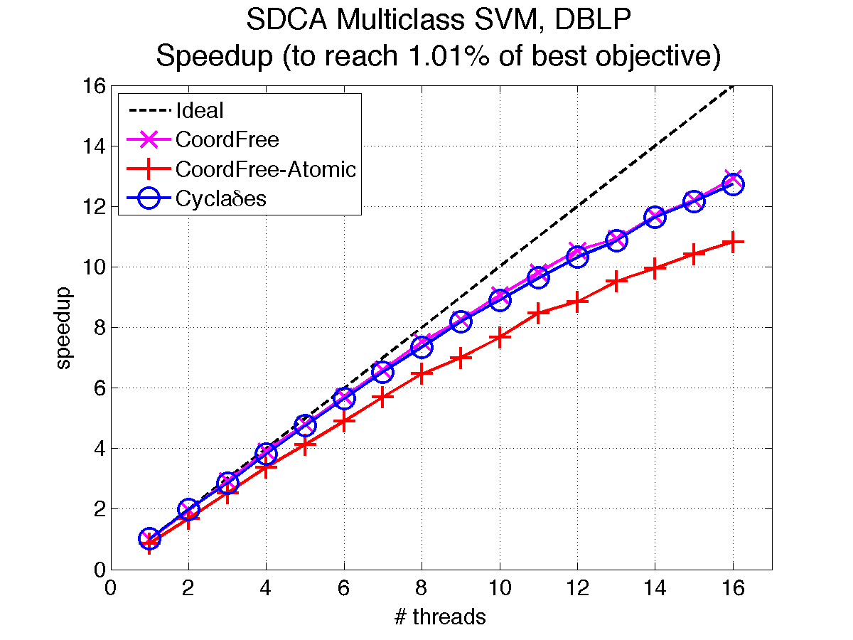
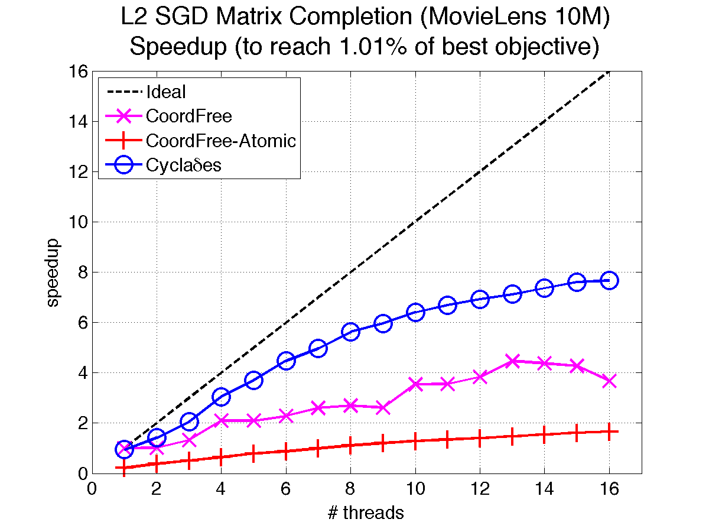
Preliminary Experiments:
Scala Implementation (2 cpus, 8 cores)

Slide 29
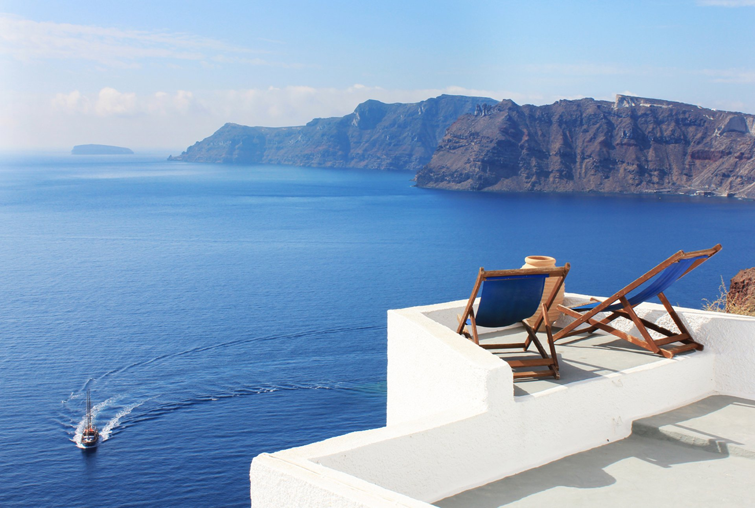
fin
Let Your Cores Run Wild!

